Slide 1

MONTHLY PERFORMANCE REVIEW (MPR) FOR THE MONTH OF NOVEMBER, 2024
TAX INTELLIGENCE & ANALYSIS UNIT
STANDARD & COMPLIANCE GROUP
PRESENTED
BY
MR. WILSON LENGTU
2024

Slide 2
TABLE OF CONTENTS
Introduction
Key Performance Metrics
Departmental Achievements
Challenges and Issues
Recommendations
Next Month’s Goals
Conclusion
Notes:
How presentation will benefit audience: Adult learners are more interested in a subject if they know how or why it is important to them.
Presenter’s level of expertise in the subject: Briefly state your credentials in this area, or explain why participants should listen to you.

Slide 3
Introduction
The TIA unit of the Standard and compliance Directorate provides tax intelligence, analyse data and serves as data bank for PSIRS.
The core mandate of the unit includes:
    Data gathering
    Data transformation & analysis
    Provision of data to support other units
    Provision data-driven insights to management
Notes:
Lesson descriptions should be brief.

Slide 4
Key Performance Metrics
Annual Revenue target 300 million
Monthly Revenue Target 25 Million
KPI | METRIC | TIMELINE
1. To ensure proper gathering and analysis of data from all sources | Transformation of data collected to inform management decision | Monthly basis, on/before 7th of the month
2. To support other groups with data-driven insights and intelligence | Collaborating with other groups to aid in the smooth running of the Service | Routine service when demanded by any group
3. To ensure that performance rate is well spelt out in our IGR report | This is the rate performance between the budgeted IGR and actual performance | On a month-to-month basis
4. To ensure good collaboration with external agencies, organization in order to share intelligence. | Information is drawn external sources to enhance the database of the Service | From time to time

Slide 5
Achievements
Intelligence:
  Mining discovery (TIN sheds in Anglo Jos)
  Shared drafts, lists, and compliance support to Revenue Operations, PIT and Compliance unit
Mop-up Summary:
  Revenue mop-up: N8.7M (November) with variance of N2.7M for the Unit
  Increased Direct Assessment revenue to N16.47M in November 2024 for the Service
  236 taxpayers forwarded for enforcement
IGR Analysis:
  63.39% IGR performance in November 2024
  5.25% growth from October to November 2024
  64.82% growth from November 2023
Notes:
Example objectives
At the end of this lesson, you will be able to:
Save files to the team Web server.
Move files to different locations on the team Web server.
Share files on the team Web server.

Slide 6
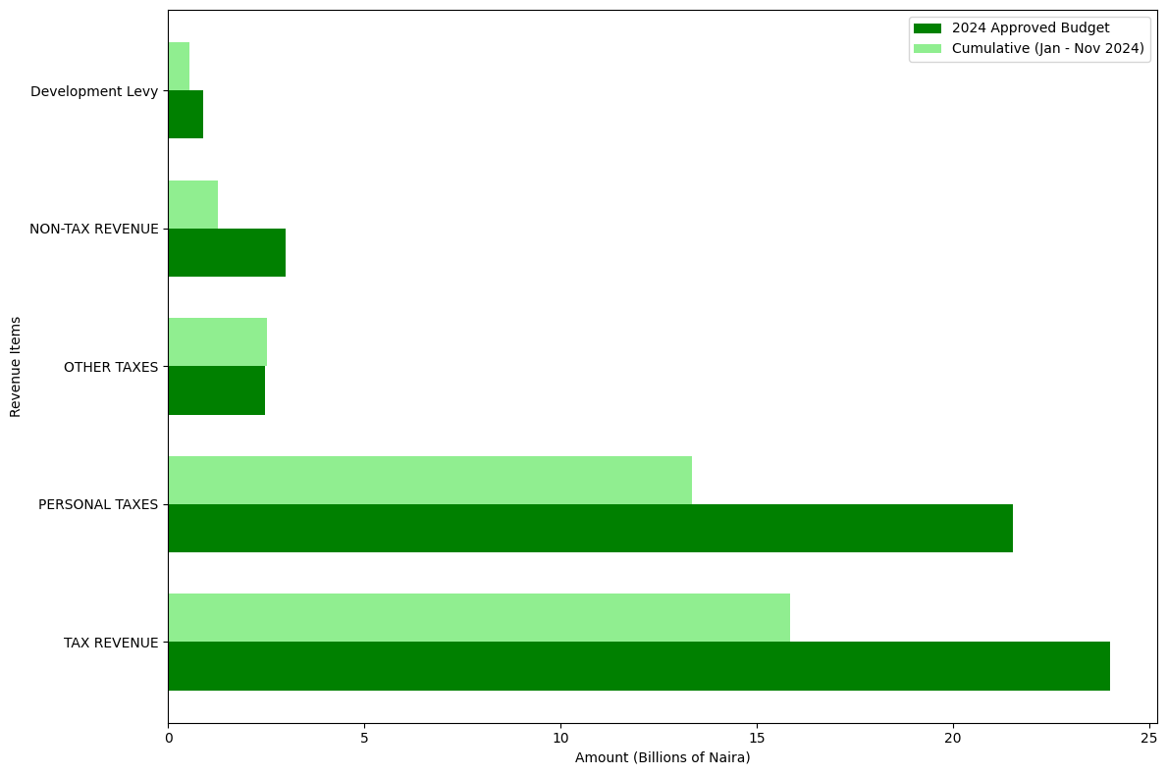
Performance Rate
INSIGHTS
Tax Revenue and Personal Taxes are the primary contributors to the budget.
Underperformance in Non-Tax Revenue and Development Levy needs to be addressed to meet fiscal targets.
Efforts to increase collection efficiency in Tax Revenue can significantly close the gap between actual performance and budgeted estimates.

Slide 7
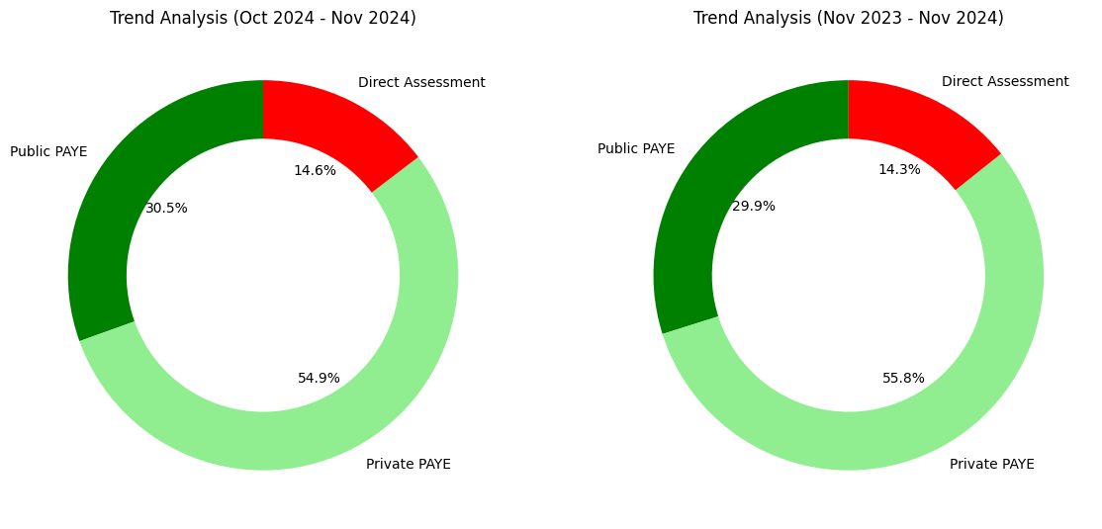
Trend Analysis
INSIGHTS
The increases in both Public and Private PAYE suggest overall growth in employment and possibly salary adjustments in both sectors.
The rise in Direct Assessment values indicates a growing number of individuals being directly assessed for taxes, which could be due enforcement.

Slide 8
Challenges
There is a challenge of vehicle for mobility for effective coverage.
Delay in compliance from unions of spare parts and tomatoes market in Farin Gada area. This tends to slow the collection process and waiting for enforcement team to help us wrap up our collections.

Slide 9
Recommendations
Invest intense enforcement with various unit for swift mop-up collections before the year ends.
Conduct an in-depth review of MDAs’ collection processes to identify bottlenecks and improve efficiency
Request for sensitization and official engagement with miners and TIN SHED owners at Industrial Area of Anglo Jos.

Slide 10
Next Month’s Goals
Update Taxpayers database and segment into LGAs, Bukuru and Jos metropolis for effective analysis, projections and collection for 2025.
Conduct further intelligence large PAYE organisations with the view to establishing consistency and completeness of tax remittances
Visit to TIN SHED along Anglo Jos for intelligence gathering
Update list of FMDAs (164) , State MDAs (96) & LGs(66), formal (68,715), Informal (431,190) for further analysis

Slide 11
Conclusion
The unit has the potential to trigger audit and discover new revenue opportunities for improved IGR.

Slide 12
Thank you

